Slide 1

Opening a new cafe in Chicago?
Where? What kind?
what else can data tell us about future business plans
by: Y.Z

Slide 2
Background
Chicago has 50 wards, different from each other economically and demographically. If a Chicagoan, weather newly relocated to Chicago, or has been living here for years but have never done investigation on different wards, would like to open a business, say a cafe, which area would be the best for him/her? Does the type of cafe matter?
Utilizing data, and methods such as regression, unsupervised machine learning, in combination with description statistics and knowledge of the neighborhood, it should be easier to find answers than to use tribal knowledge alone.

Slide 3
Data
Raw Data include:
Chicago geo data: ward(neighborhood) and it's coordinate
CTA public transportation: CTA L Trains stops, station name and coordinate
Divvy: Chicago bike share, station coordinate
Crime: city crime records, crime type and coordinate
foursquare datasets: split venue into retail(including goods and service) and enviroment(including public recreational area)
All city data come from https://data.cityofchicago.org/

Slide 4
Methodology: Overall
Hypothesis 1: number of cafe will correlate with public transportation; recreational area such as park, and negatively correlate with crime rate:
Use normalized dataset to generate correlation, if there is high correlation, then find the proper regression, use the prediction to find a ward currently with less cafe then predicted.
Hypothesis 2: number of cafe would not have a strong correlation with any other factor in the dataset:
Use Kmean to find clusters for neighborhoods. Then based on statistics of each cluster, find the ward within the cluster that has a demand for cafe, that seems unmet.

Slide 5
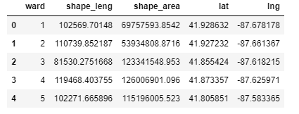
Methodology: Data
Geodata:
Geodata is aquired from data.cityofchicago.org in json format, ward number and coordinates are extracted.
Use ward instead of neighborhood name as ward is more “offically” and better defined.

Slide 6
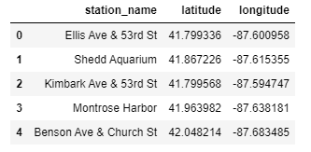
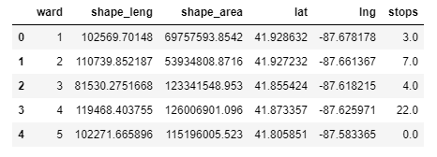
Methodology: Data
CTA L train stops and Divvy bike share stations :
Both data are aquired in json format, station/stop names and coordinates are extracted into data frame.
Distance between each ward and each station/stop is calculated use coordinates, then total count of stations/stops within a defined “distance” to each ward is summed up, and added to the data set.

Slide 7
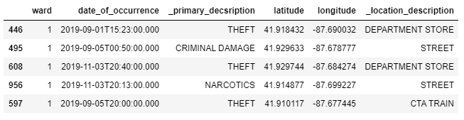
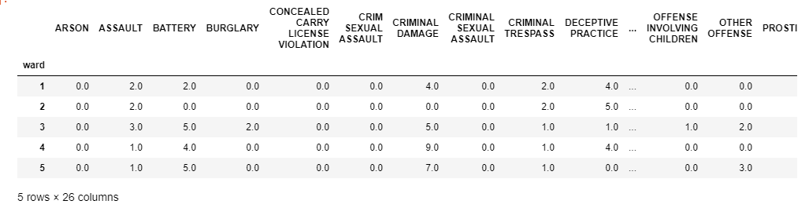
Methodology: Data
Crime Data
Data is aquired in json format, crime type, ward, coordinates are put into a data frame.
Group by ward and crime type, then pivot to calculate a total crime count for each ward, before added to dataset.

Slide 8
Methodology: Data
Foursqure Data
First all venue data are gathered using explore, radius set to 10km (~6mi)
category of venue is investigated, and divide into three type:
enviroment: such as park, beach, garden, museum, stadium
unrelevant: such as bank, apartment
retail: all stores provide goods/services, such as restaurant, cafe, spa
Frequency data is generated based on retail category only, then top venue of each ward is calculated use this frequency
Venue count is further grouped by category, into:
cafe: cafe, coffee shops, game cafe
other drinks: tea house, juice bar
snack: bakery, donut shop, ice cream shop, froyo shop

Slide 9
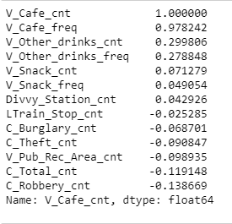

Analysis and Findings
The complete dataset is first normalized, then correlation is calculated based between count of cafe with all other variables
number of cafe does not have a strong correlation with any other variables, it has negative correlation with all crime data, yet also with public recreation area, even with park alone

Slide 10
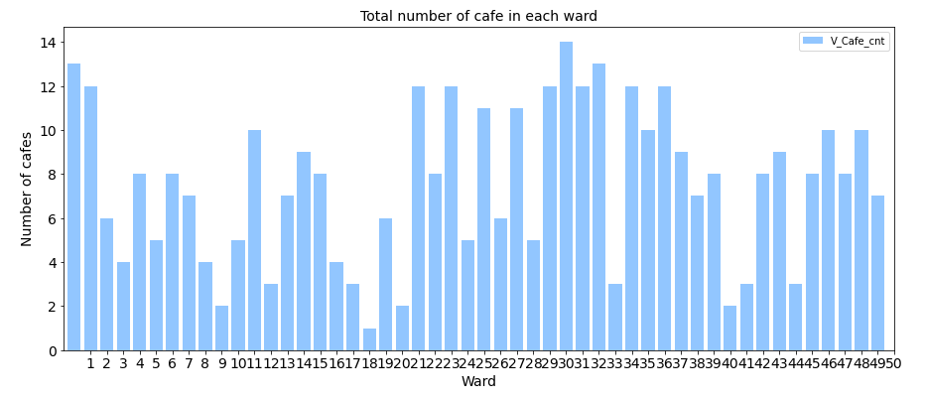
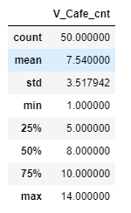
Analysis and Findings
Number of cafes statistics and bar chart shows most wards have around 7 and a half cafe within 6mi radius, and it's somewhat normally distributed based on median, mean and std.

Slide 11
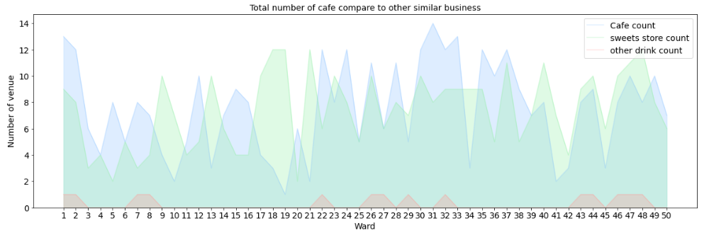
Analysis and Findings
Area chart shows that although sweets shops and cafe do not have a strong correlation, their trends do align, expecially for wards 42 to 50, shown by the orange circle.
Also shows by the chart other drink shops have too small of a sample size.

Slide 12
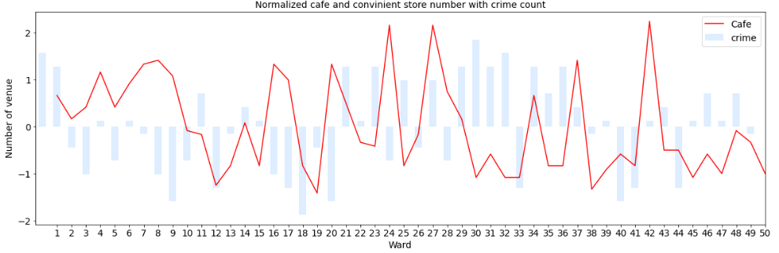
Analysis and Findings
Although crime count and cafe number has a weak negative correlation, the chart helps to visualize the trend. also visualize the crime count.
Similar chars was also done agaist public park/recreation area.

Slide 13
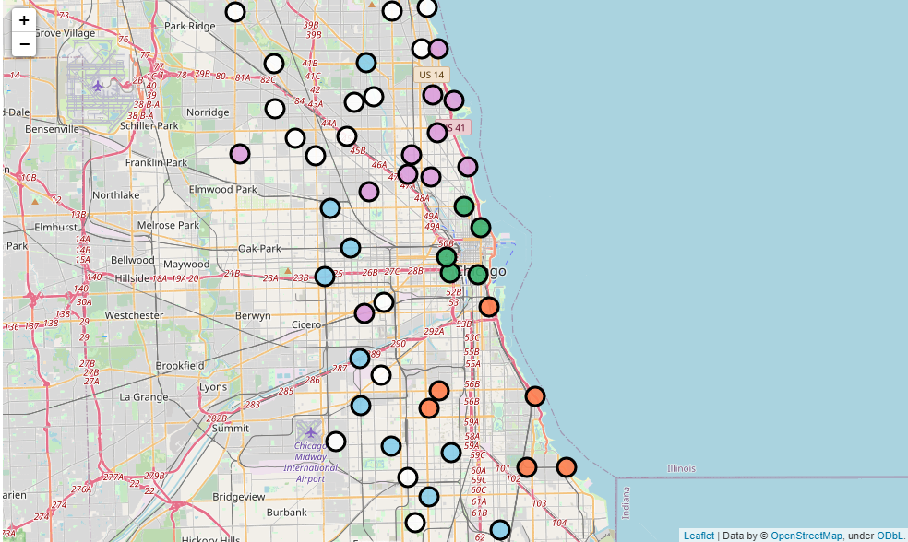
Analysis and Findings
Use Kmean on normalized dataset give the following cluster, can clearly identify clusters of neighborhoods.

Slide 14
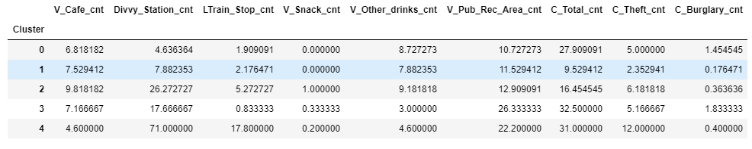
Analysis and Findings
Mean of all variabls by clusters give more insights.
cluster 0: blue, 1: white, 2: plum, 3: orange, 4: green
Cluster 4 is downtown area, with more public transportation, more public rec area, and higher crime, however less than average number of cafe
Cluster 3 seems to be the neighborhood with the highest crime rate.
Cluster 2 has more cafe than average, will face competition if would like to enter
cluster 1 and cluster 0 seems to be ideal.

Slide 15
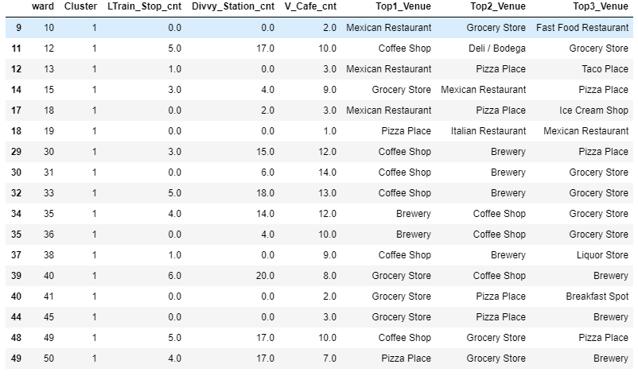
Analysis and Findings
Look at the detail data of all wards in cluster 0 and 1 will give a better idea for the strategy. For example to target wards with cafe not in top 3 venues, like ward 50.

Slide 16
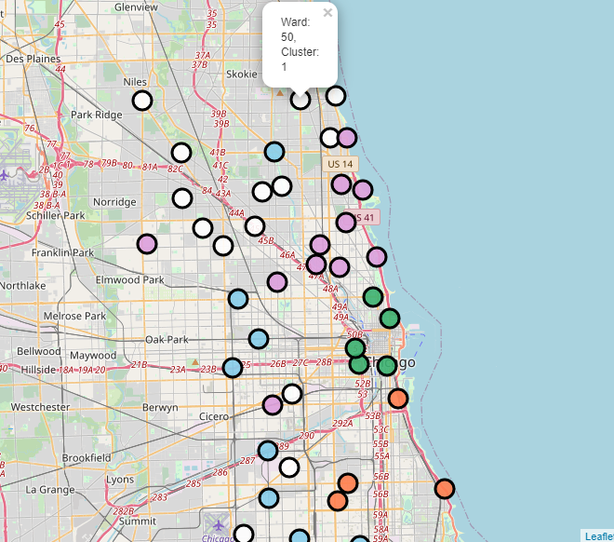
Recommendations
Based on all the information I could have gathered and validated, if one would like to opn a new cafe, it can either be in ward 50. which belongs to a cluster with lowerst crime rate, and average number of cafe. Within it's cluster, ward 50 does not have as many cafe as other wards.

Slide 17
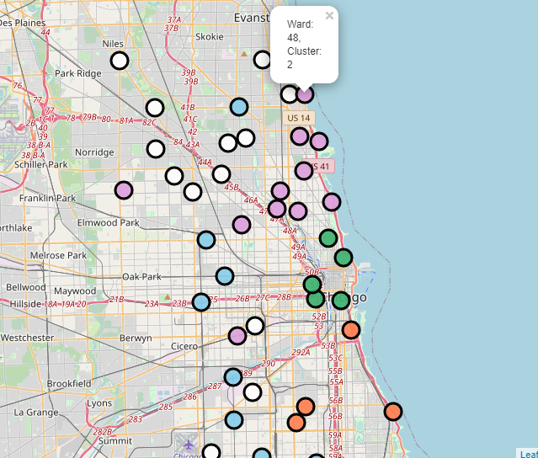
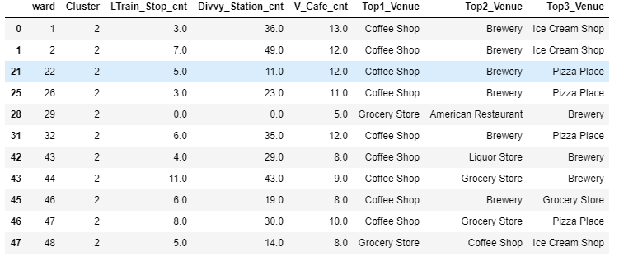
Recommendations
Or one can choose to open in ward 48, which belongs to the cluster with the highest number of cafe, and it is one of the only two wards within the cluster, that cafe shop is not the top 1 venue. Compare to ward 29, ward 48 has more public transportation.

Slide 18
Conclusion other than recommendations
Foursquare data is not as comprehensive as Google map or Yelp, it would have been nice to be able to have Chicago data in Yelp public data set.
Method to calculate area of wards, amenities and venues within it, is not accurate. Border is available, however I'm not able to utilize them effectively.
Would like to gether more data, and to do ML or simply correlation analysis on more variables, to find if number of cafes truly have no strong correlation with any other factors.
With enough data, it would be beneficial to compare different types of cafe, such as chain vs local business, specialized cafe shop vs generic.

